Slide 1
Unit 27
Server Side Scripting

Slide 2
Unit brief introduction
When designing and building websites, a key issue for developers is the amount of control they can exert over how tasks are carried out.
Client-side scripting embedded in web pages can give additional functionality but, because the code is executed after the page has been loaded, there is little control and this approach can lead to hacking vulnerabilities and errors.

Slide 3
Unit brief introduction
Web server scripting is code written ‘server-side’ and executed before the page is loaded.
This means that complex tasks can be created and programming is generally more secure.
The skills and knowledge developed in this unit are particularly valuable because security and reliability are common issues for businesses.

Slide 4
What is server side scripting?
Server-side scripting is a web server technology in which a user's request is verified by running a script directly on the web server to generate dynamic web pages .
(http://en.wikipedia.org/wiki/Server-side_scripting)
It is used to create dynamic web pages
Unlike client side scripting, the code is secure as it cannot be viewed on the client

Slide 5
Static web pages
The server contain .HTML files
These are served to the client browser on request
The local browser may have some interaction via client-side scripting (JavaScript)
The HTML pages are fixed and cannot be altered to match individuals requests

Slide 6
Dynamic model
HTML pages are generated when they are requested
The basic page is done in a scripting language and uses HTML and CSS to determine static content and appearance
The variable data is generated by scripts (an interpreted program) running on the web server

Slide 7
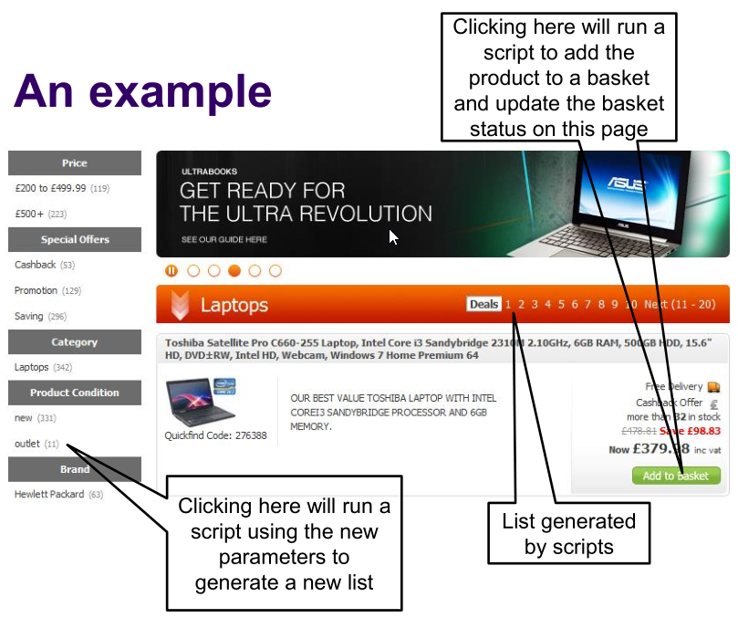

Slide 8
Other uses
Updating databases
Interacting with forums
Gathering user statistics
Managing profiles
Blogging
Sharing (upload to Web 2.0 applications)

Slide 9
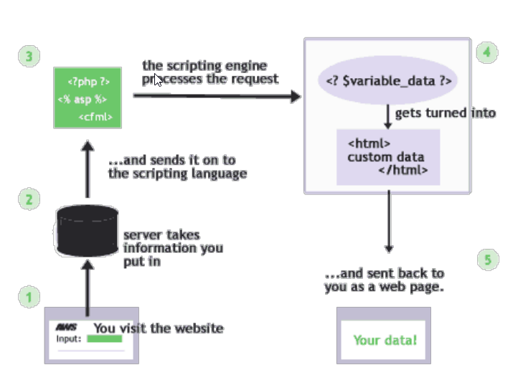
How does it work?

Slide 10
‘Classic’ ASP
Active Server Pages (ASP)
a server-side scripting environment from Microsoft
Uses a file extension of .asp
Scripts are usually written in VBScript
Classic ASP will normally run only on Microsoft servers
Classic ASP is an Interpreted language
https://www.sitepoint.com/community/t/interpreted-vs-compiled/70682
Not to be confused with ASP.NET or ASP.NET Core

Slide 11
ASP.NET
The successor to Microsoft's ASP
Allows programmers to create web applications using any scripting or programming language supported by the .NET Framework.
The main building blocks are pages known as web forms, which contain definitions for server-side Web Controls and User Controls
Web forms have the file extension .aspx
ASP.NET and ASP.NET Core are compiled:
https://softwareengineering.stackexchange.com/questions/84518/can-i-say-that-asp-net-is-compiled

Slide 12
ColdFusion Markup Language (CFML)
A scripting language originally introduced by Adobe Systems in 1995
Enables web developers to embed database commands and other server-side scripting elements within standard HTML or XHTML
Pages in a ColdFusion web application are pre-processed by the ColdFusion Application Server when requested by a client browser
CFML is interpreted

Slide 13
Perl
A high-level, interpreted programming language
A procedural programming language loosely based on C
Used for the creation of web applications, especially those where database access is required.
Perl is free software

Slide 14
JavaServer Pages (JSP)
Java technology similar to ASP
Used to create dynamically generated web pages by embedding Java programming code in HTML or XHTML documents
A JavaServerPage is compiled into a Java servlet by an application server, rather than being interpreted
(a servlet is a Java program that executes on the server to create dynamic web pages).
JSP pages are compiled at runtime, unless you specifically precompile
https://stackoverflow.com/questions/10607415/how-does-jsp-work/10607567

Slide 15
PHP
A widely-used scripting language
PHP is free software
PHP code can be embedded into HTML or XHTML documents
It is executed on the server to generate dynamic web content.
PHP is frequently used together with MySQL/MariaDB, and is one of the key technologies in the LAMP stack
Linux
Apache
MariaDB/MySQL
PHP
Is PHP interpreted, compiled or … both?
https://en.wikipedia.org/wiki/Interpreted_language

Slide 16
What we will use for this unit
Web server scripts written in PHP
Database commands written in SQL (structured query language)
Client scripts written in JavaScript
Apache Web server
MySQL database managed with PHPMyAdmin
PHP interpreter add on to Apache
Visual Studio Code

Slide 17
A simple PHP script
<!DOCTYPE html>
<html lang="en">
<head>
<meta charset="UTF-8">
<meta name="viewport" content="width=device-width, initial-scale=1.0">
<meta http-equiv="X-UA-Compatible" content="ie=edge">
<title>Today's Date</title>
</head>
<body>
<p>
Today's date, according to your webserver is:
<?php
echo date('l, F dS Y.');
?>
</p>
</body>
</html>

Slide 18
Client side and server side
Client side
Reduces web traffic as processing done on client
Good for
Form validation
User aids (drop downs, hover etc)
Local navigation
Server side
Can use centralised server resources eg databases
No client plug-ins required, runs in any browser
No load on client, can use powerful server hardware
Applications do not need distributing

Slide 19
Results
Browser displays:
Today’s date (according to this web server) is Wednesday, December 11th 2019.
Source is:
<body>
<p>Today’s date (according to this web server) is Wednesday, December 11th 2019.
</p>
</body>

Slide 20
Combined use
Build efficient applications
Choose to do the processing in the most appropriate location
Choose where to keep up to date multi use data
Choose how to optimise the user experience:
Performance
Appearance
Function

Slide 21
Summary: web server scripting
Advantages
Disadvantages
Interpreted, low processing overhead
Interpreter is integrated into web server, so it is fast
Secure, code runs on server
Content based on live data
Can use basic, eg phone, browsers as processing is server side
Debugging tools can be scarce
Can be more difficult to develop
Requires a running server to test
Has no direct control over the user interface

